Slide 1
Online Learning System for Python Scrapper
– Group 6 –

Slide 2
Contents
Backend
Frontend
IDE
Interaction
Server environment

Slide 3

Backend – Node.js
Server configured with express module
Communicates with MySQL DBMS using sequelize module

Slide 4

Backend – MySQL
Database table structure
User
id (PK): bigint, email: string, password: string
Tutorial
id (PK): bigint, chapter: string, title: string, content: string
Problem
id (PK): bigint, chapter: string, problem: string, answer: string
UserProblemSet
id (PK): bigint, user (user.id), problem (problem.id), is_solved: enum [“Y”, “N”]

Slide 5


Frontend
Based on Next.js and React
Provides web page component structures
Such as log-in page and problem pages
Communicates with backend to fetch contents

Slide 6
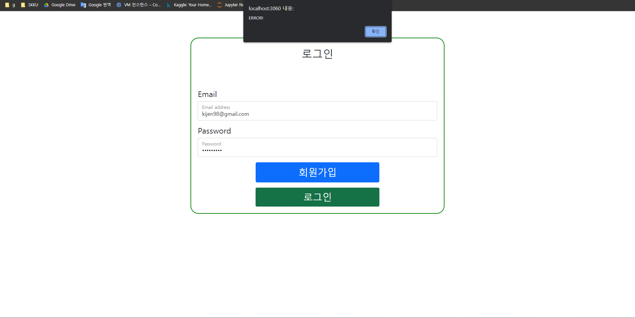
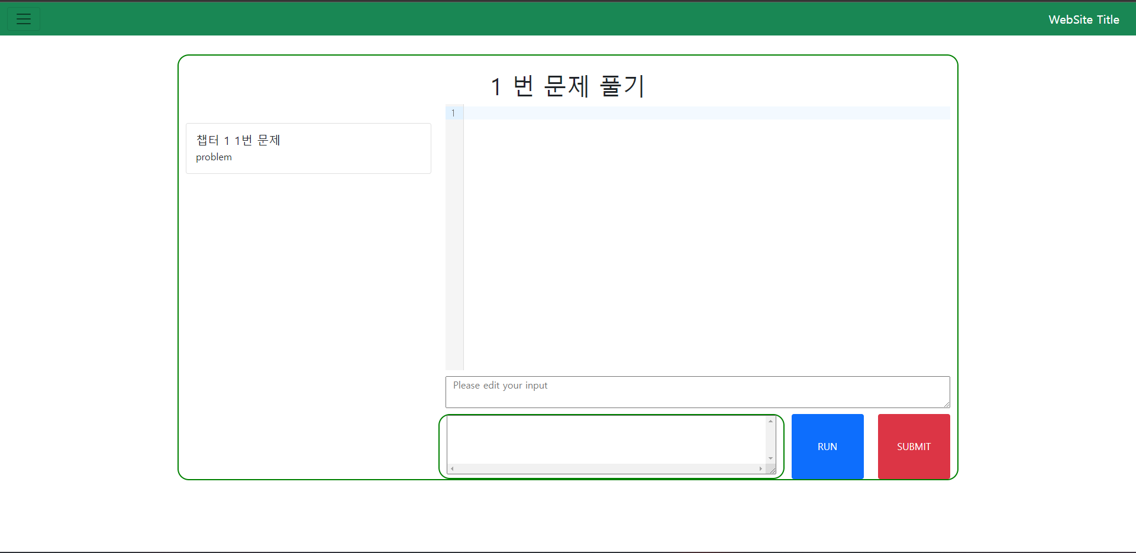

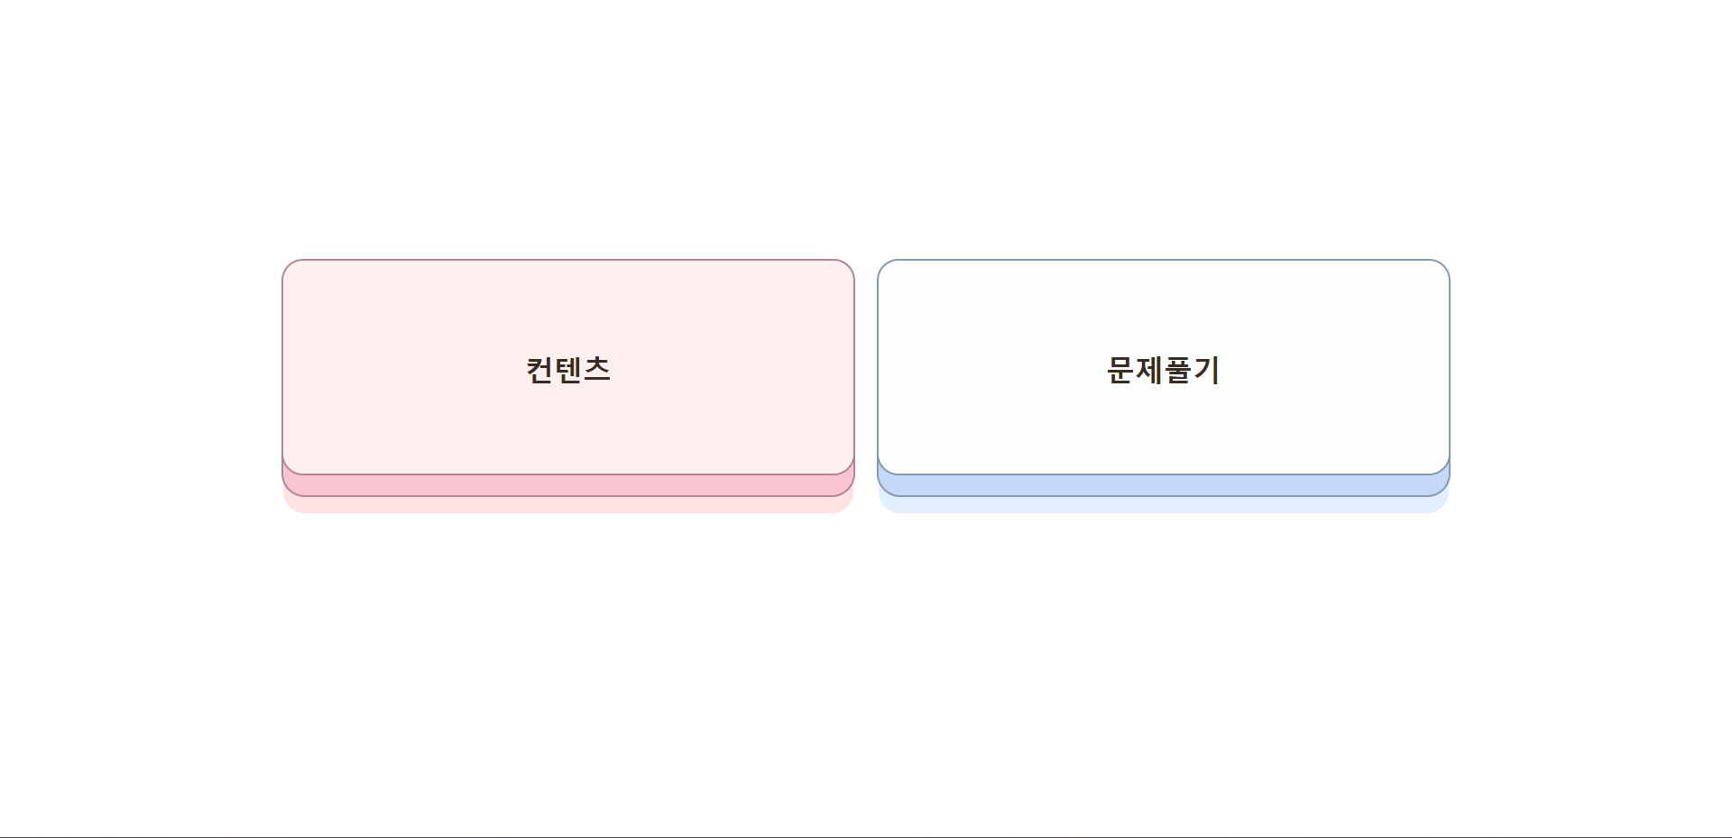
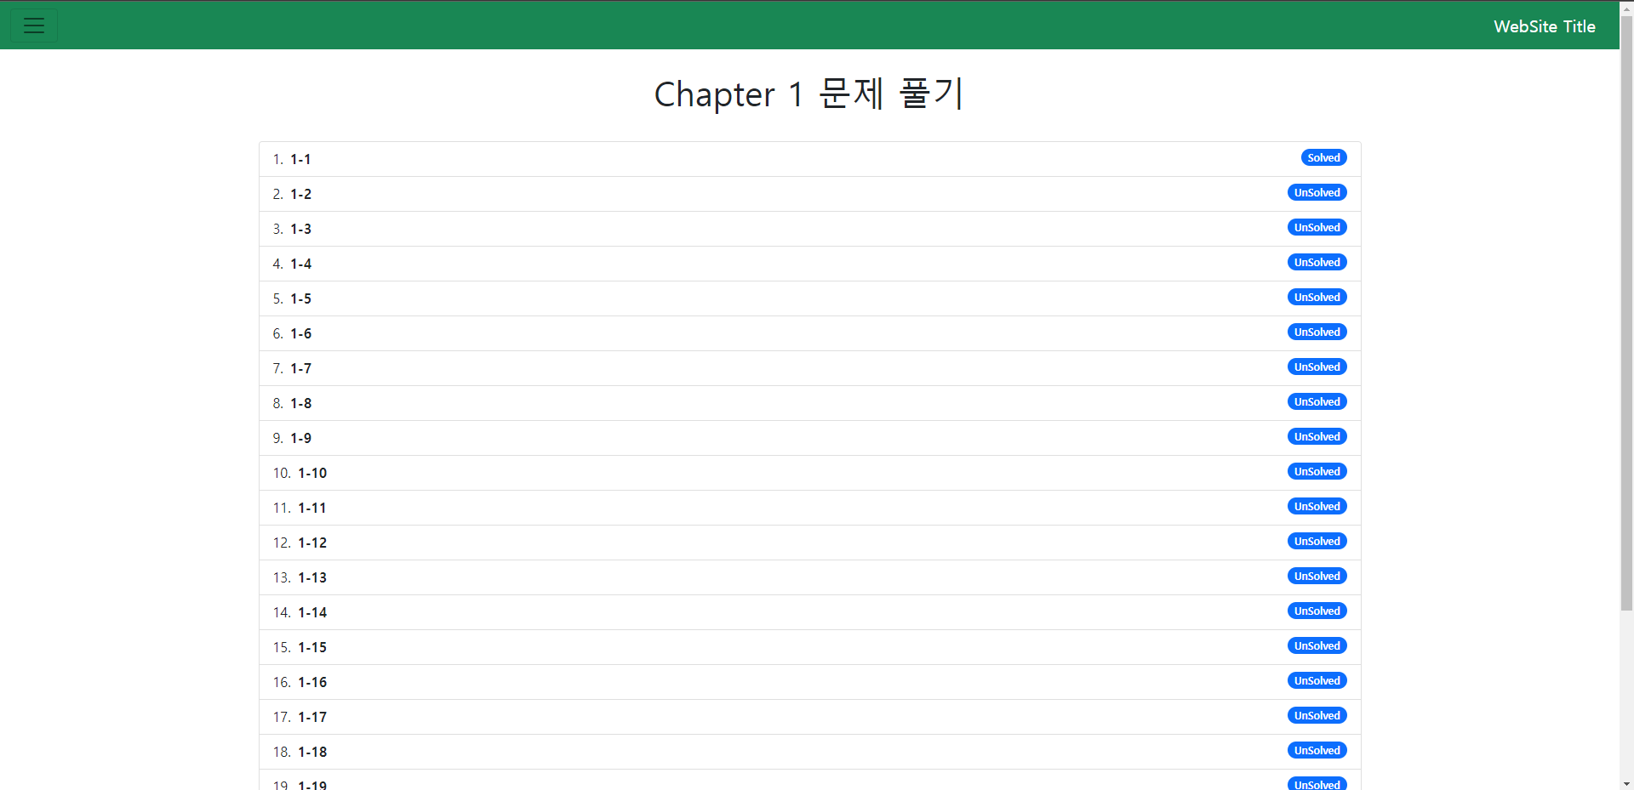
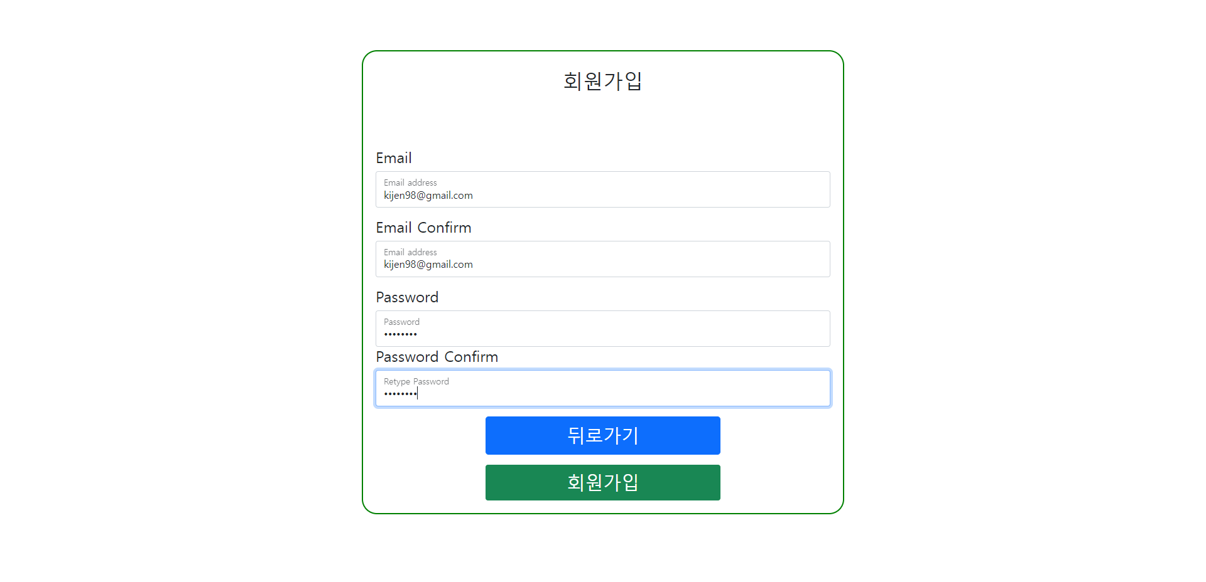
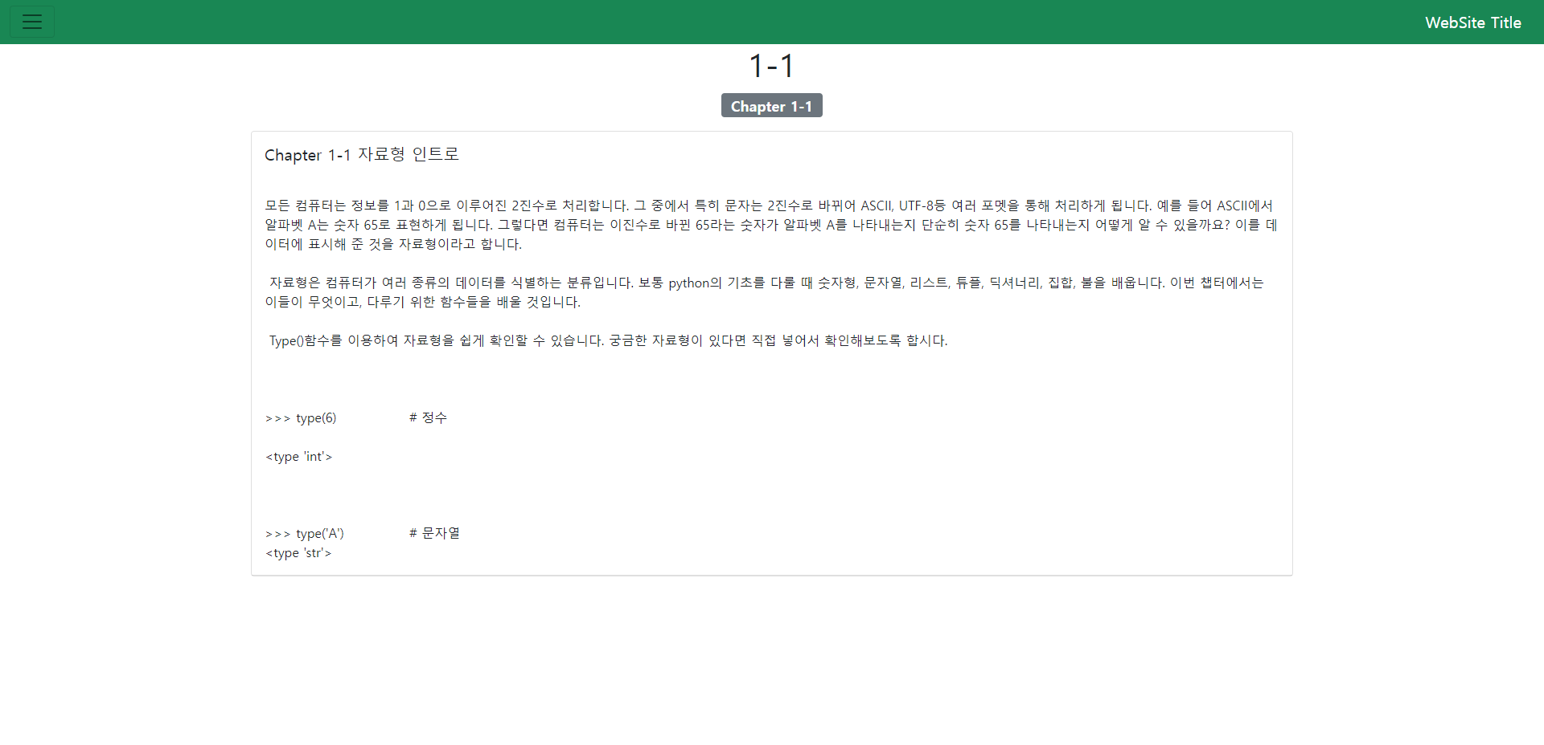
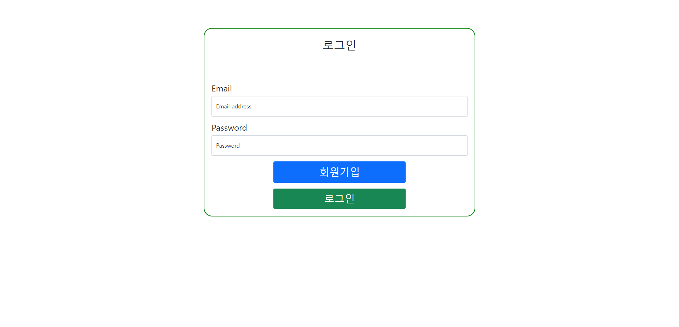
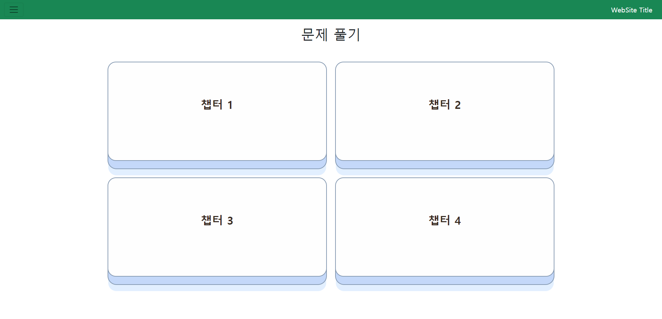

Slide 7
IDE
CodeMirror-based Python IDE
Axios module
to send user codes to the server to run
Python Docker container
User-submitted codes run on this
Result returned and shown in web page via runcode API
React
CodeMirror
Python3 on Docker
Axios

Slide 8
Interaction
Dependency and Docker containers maintained by two shell scripts run.sh and stop.sh
Node.js server, MySQL, and Python3 bound by Docker
Backend and frontend running on single Node.js server

Slide 9
Server Environment
Deployed and tested on a personal NAS

